Slide 1
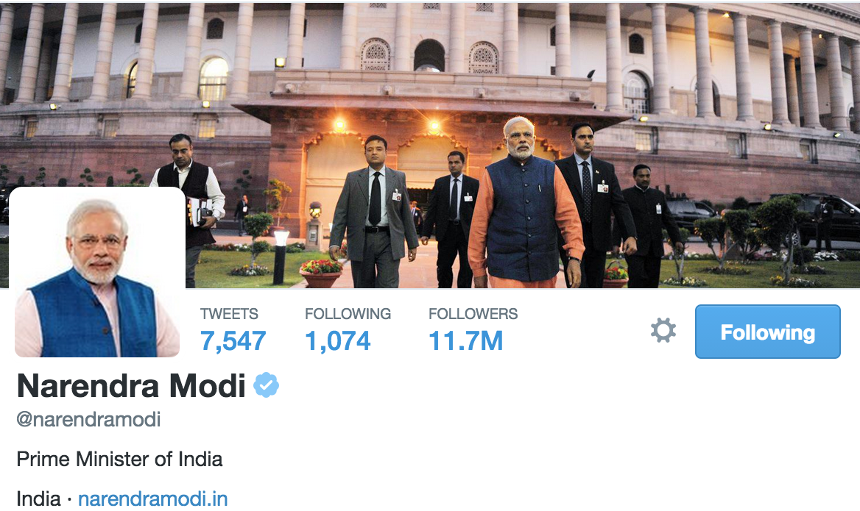
Visual Politics: What Makes a Political Rockstar Follow a “Casual User”?

Slide 2

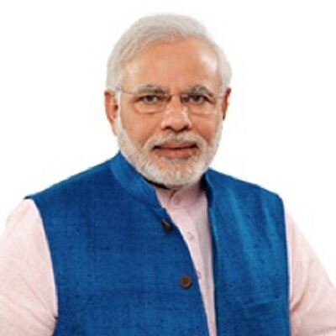
Background
Indian Prime Minister Narendra Modi, elected in May 2014, followed 408 casual users in twitter during the year leading up to elections.
Member of the majority Bharatyya Janata Party
Born in 1950 in present day Gujarat
Humble Beginnings
Became involved with politics in 1974 (Navnirmam Movement)

Slide 3
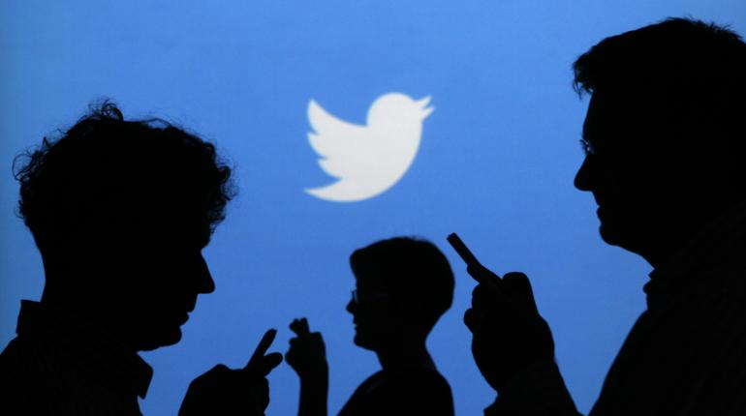
Who are these 408 users?
Writers, self-described ”Proud Indians”, Students, Producers, BJP Grass-Root Workers, IT workers
They current live across India, with a few outside of the country.
New Delhi, London, Kolkata

Slide 4
Domain Question
Are there keywords that lead Modi to follow casual users?
How many of them retweet Modi’s tweets? How often do they retweet?
Given a number of topics/words, does their usage change over time around election period?
Our data
Complete twitter feeds(time, content) these 408 users sent out for one year
One file consists of approximately 6000 tweets sent by Narendra Modi

Slide 5

OUR SOLUTION

Slide 6
Design Decisions – STORY TELLING
Orient the user to the topic
Text to complement visualizations
Inspiration from New York Times article
Author driven approach but a few visualizations talk give readers flexibility to derive their own conclusions

Slide 7
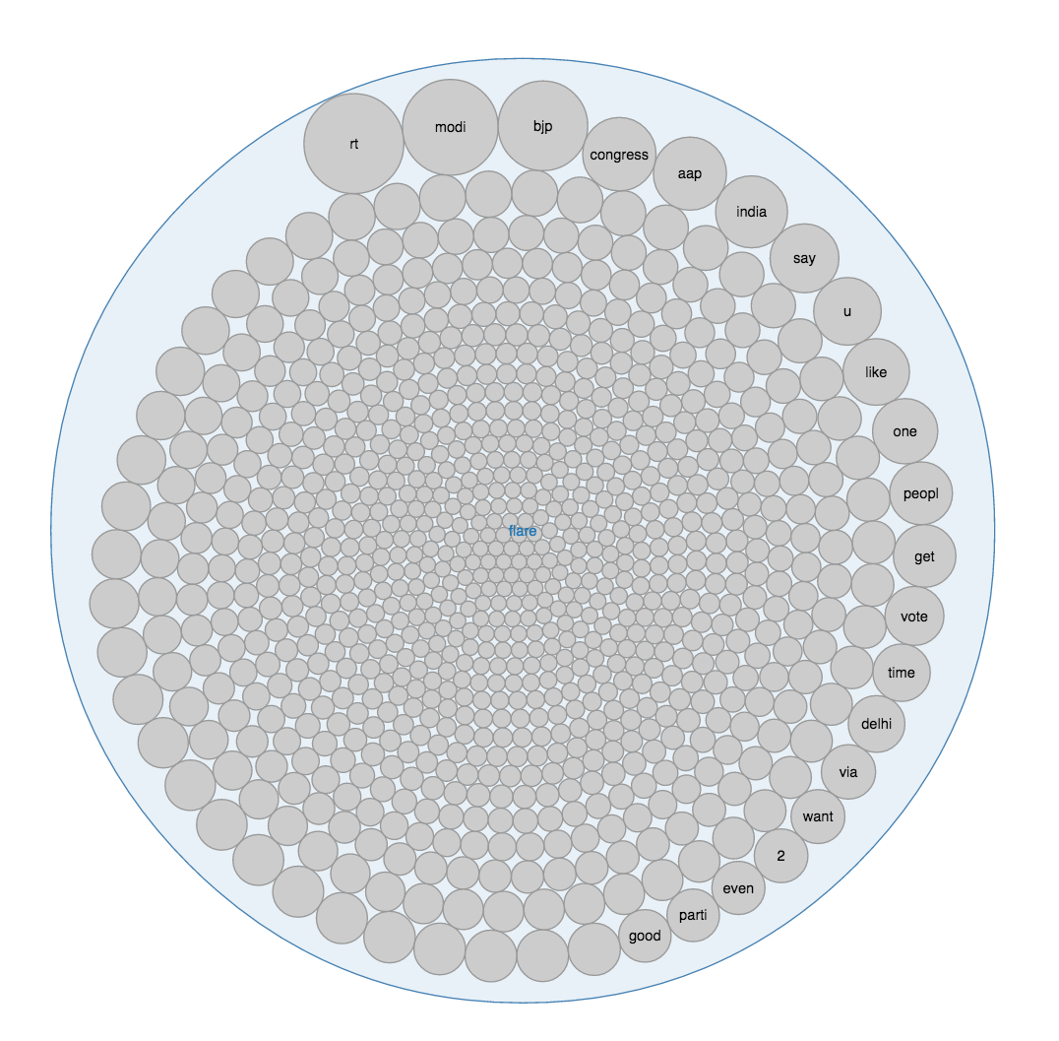
Design Decisions – Text Circle
Effective:
Effective for highest frequency words / terms
Expressive:
Shows the size of highest frequency of any word
Allows comparison for anyone
Preattentiveness
Highest frequency words are immediately noticed
Interactivity
Elaborate by hover over a circle

Slide 8
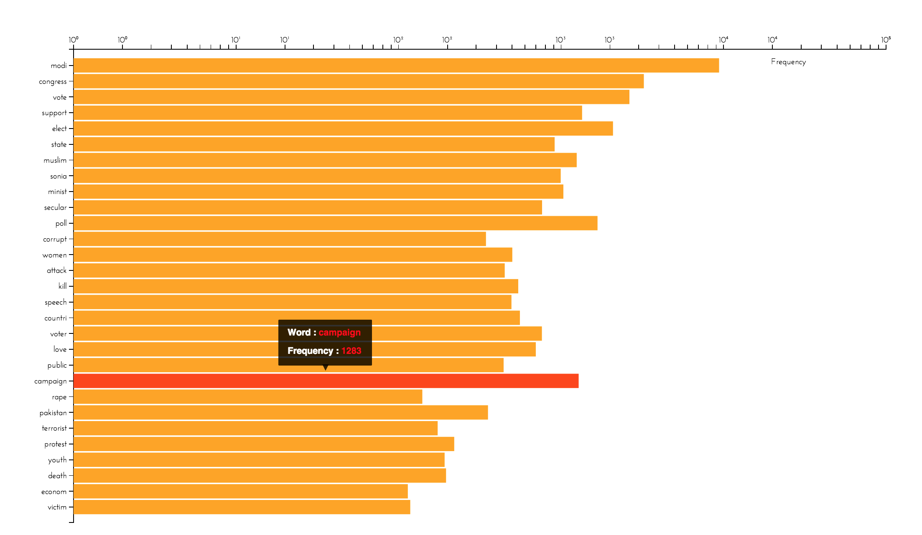
Design Decisions – Words over time
Effective:
Length is good for comparing between words.
Good for comparing particular words over time.
Frequency of the word
Expressive:
Frequencies are encoded by length and exact number.
Interactivity
Reconfiguration
Encoding

Slide 9
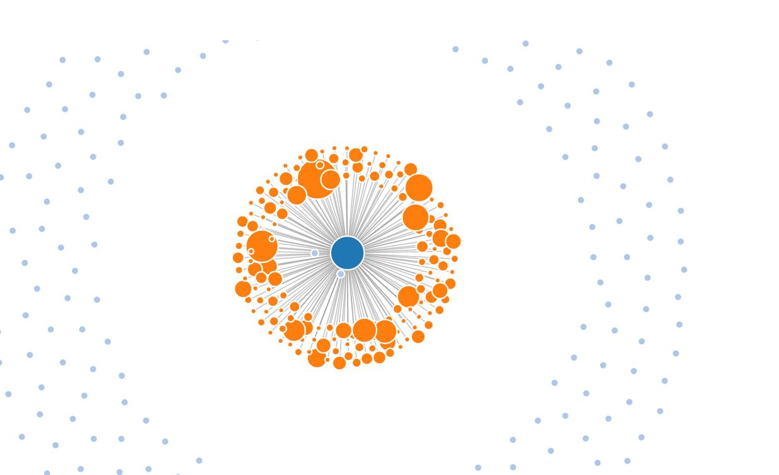
Design Decisions - Network
Effective:
Link to show if a user has retweeted
Size of the node depicts the number of retweets
Expressive:
Area is limited for similar sizes so it is expressive but not very effective
Interactivity
Hovering for detail

Slide 10
Questions / FEEDBACK

